Slide 1
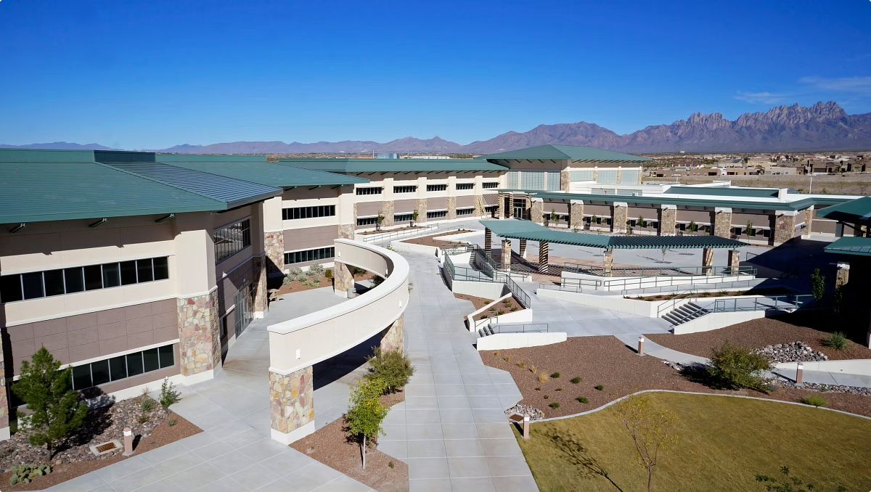
VA RESOURCE CENTER: Educational Benefits Orientation
Welcome to the VA Educational Benefits Orientation. We help first-time students understand how to use and maintain their VA benefits.
by Crystal Davila

Slide 2
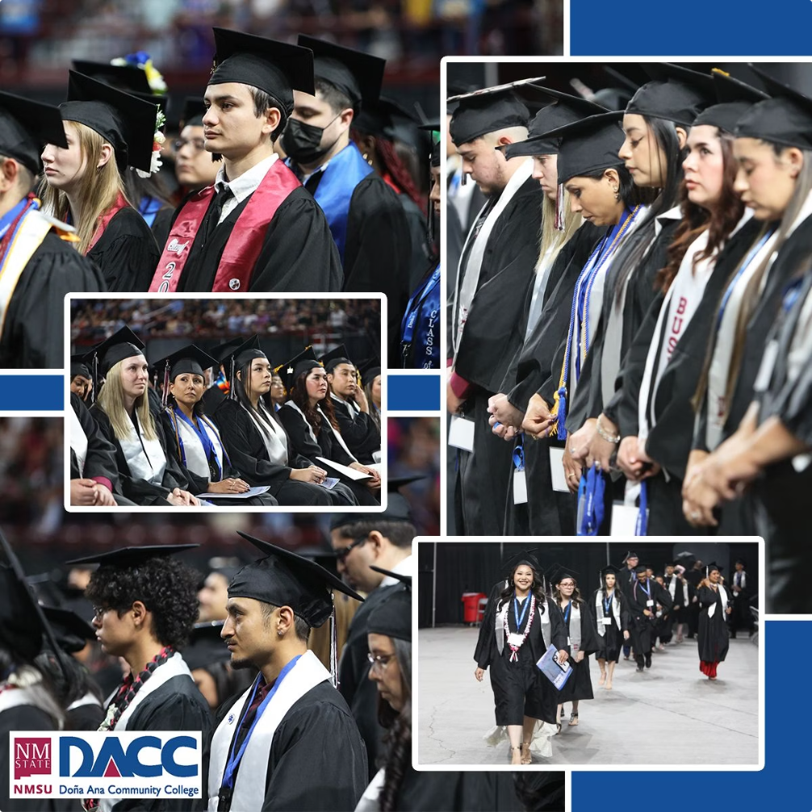
Who We Are
Connection Point
We are the bridge between the school and the VA.
Enrollment Verification
We ensure VA students are taking the right classes for benefits.
Certification
We certify to the VA that students are taking eligible classes.
Communication
We facilitate information flow between the VA and school.

Slide 3
Types of VA Educational Benefits
Post-9/11 GI Bill (Chapter 33)
Montgomery GI Bill (Chapter 30 & 1606)
Covers tuition, fees, housing allowance, and book stipends.
Provides monthly education stipend for veterans and reservists.
Survivors and Dependents (Chapter 35)
Veterans Readiness & Employment (Chapter 31)
Financial assistance for eligible dependents of disabled or deceased veterans.
Covers tuition, books, and supplies for veterans with service-connected disabilities.

Slide 4
Step-by-Step Guide to Using VA Benefits
Apply for VA Benefits
Visit benefits.va.gov/gibill and complete VA Form 22-1990 for first-time applicants.
Submit Required Documents
Provide Certificate of Eligibility, forms, military transcripts, and class schedule to SCO.
Reapply Each Semester
Benefits are not automatic. Report any enrollment changes immediately.
Monitor Communications
Check VA.gov and school emails regularly for updates on payments.

Slide 5
Enrollment Requirements & Deadlines
Submit Early
Early submission allows time to resolve course conflicts and maximize benefits.
VA Hold
Protects your benefits by preventing schedule changes without notification.
Schedule Changes
Submit updated schedule and STAR Degree Audit if you change classes.
Payment Impact
Adding/dropping classes affects training time and Monthly Housing Allowance.

Slide 6
Continuing Benefits for Future Semesters
Submit Class Schedule
Provide your current class schedule each term
Update STAR Degree Audit
Submit your latest degree progress report
Request Certification Early
Benefits are not automatic - request every semester

Slide 7
Common Mistakes to Avoid
Unreported Schedule Changes
Non-Approved Courses
VA only covers classes required for your degree
Can lead to overpayments and debt to VA
Late Submissions
Missing Priority Registration
Causes delays in tuition payments and stipends
Veterans qualify after first semester

Slide 8
Important Resources & Support
Contact Info
Office Location
Helpful Websites
Phone: 575-528-7315 Email: vetprog@dacc.nmsu.edu
East Mesa Campus DASR Room 111 Monday-Friday, 8am-5pm
NMSU Military and Veterans Program VA Education & Training
Additional Support
Advising, Financial Aid, AVANZA, Student Accessibility Services

